Slide 1
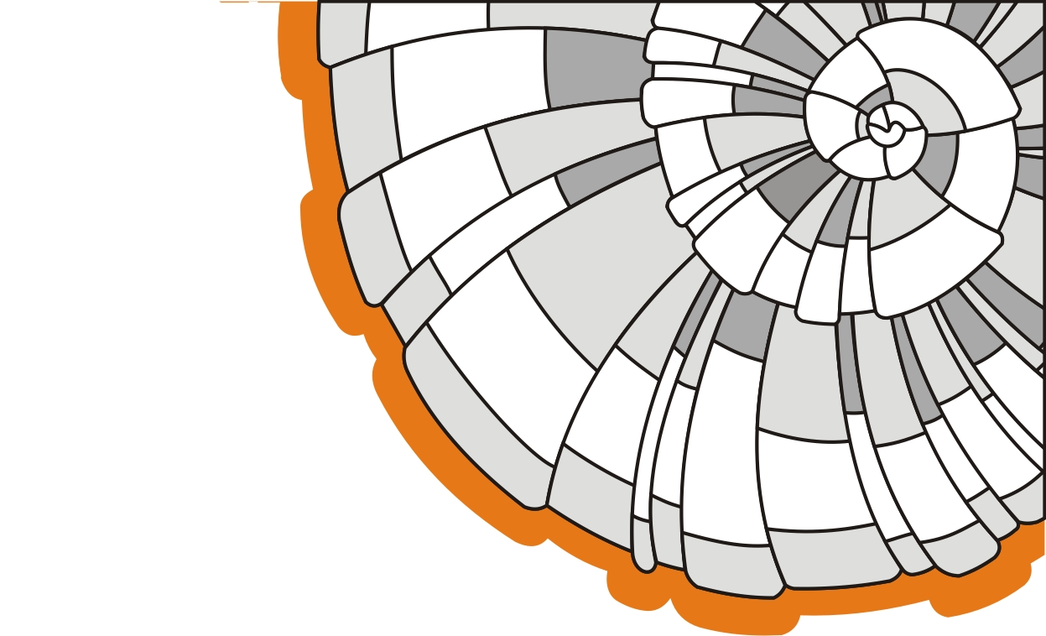

ISOLLAT 02
Certification and testing
Insulation of any surface
THERMO PAINT
http://www.isollat.ru

Slide 2
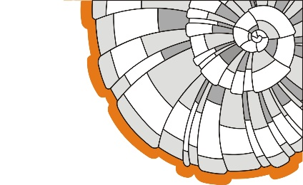
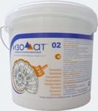
Insulation coating Isollat
Company Special Technologies LLC was founded in 2002 on base of the Institute of High Temperature Electrochemistry of the Ural Branch of the Russian Academy of Sciences in cooperation with several companies of the military industrial sector. Currently, liquid ceramic coating Isollat is widely used in various facilities (industry, power, construction, utilities) in Russia and abroad.
Isollat is a modern high-tech thermal insulation material, which is widely used for insulation of facilities of various applications: industrial and residential construction, power industry, housing and public utilities, oil and gas complex.
Isollat forms a polymeric lightweight, flexible, resilient, and durable coating that is not subject to burning, resistant to damage, and provides a significant reduction of heat losses from insulated structures.

Slide 3
Insulation coating Isollat
Isollat is a viscous water-based suspension, which is easily applied to all surfaces of complex shapes and configurations, and serves as a ready topcoat after drying and polymerization.
Isollat is designed for thermal insulating and corrosion protection of heating systems, heating and industrial equipment, for the protection of building structures, facades of residential and industrial buildings. The coating effectively reflects and scatters radiation in the visible and infrared light, and is adhesive to most materials. The life time of the material is more than 10 years without loss of performance.
In comparison with other insulating materials, Isollat coating has a number of advantages that provide high efficiency of its usage:

Slide 4

Isollat coating advantages
Long-life performance
Environmentally friendly
Wide range of temperatures (from -60 to +150°C)
Minimum thickness of the coating layer (0.5 to 3 mm)
Reduced labor cost
Ease of installation
Short turnaround time without suspension of production
Applied on any surface
Used in conjunction with other building materials
Serves as a ready topcoat

Slide 5
Thermal insulating coating Isollat 02
Isollat 02 is the most widely used coating in the product line of Special Technologies LLC.
Isollat 02 is the universal thermal insulation material with a wide range of applications. It is used for integrated thermal insulation and anticorrosion protection of pipelines (steam pipelines) and elements of pipeline systems, industrial and boiler equipment, tanks and vessels with temperature of heat carrier up to +150°C, and up to +170°C in peak mode. Flammability group – Г1.

Slide 6
Physical and mechanical properties of Isollat coating
Type | Water-based acrylic coating | Technical specifications
Color | White with possibility of light colored | Technical specifications
Elongation rate | ≥ 5% at room temperature | own tests |  | slide No. 13
Wet weight | 0,5 kg/liter | GOST 31992.1-2012 | ISO 2811-1:2011 | slide No. 11 | appendix3. Akademsib
Coating density | 0.3 kg/dm3 | GOST 17177-94 |  | slide No. 13 | appendix4. Uralplastic
water vapor permeability | 0.012mg/(m·h·Pa) | GOST R EN 12086-2008 | EN ISO 7783: 2012 | slide No. 9 | appendix2. BTRI
water permeability | ≤ 30 gr/m2/24h |  | EN 1062-3: 2008 | slide No. 9 | appendix2. BTRI
apparent viscosity | 16,000 sP | GOST 25271-93 | ISO 2555-89 | slide No. 12 | appendix3. Akademsib
strength at break | 80 kgf/cm2 | GOST 14236-81 |  | slide No. 13 | appendix4. Uralplastic
Film shrinkage after drying (thickness) | 5% | own tests |  | slide No. 15
Dry film weight | 0,15 kg/m² at 0.5 mm | own tests |  | slide No. 15
Solar light reflectivity | 0.8 | own tests |  | slide No. 14 | appendix5.Samara
UV reflection | 95% | own tests |  | slide No. 16
Adhesion | 25 kg/cm² | GOST 15140-78, GOST 28574-90 | EN 1542: 1999 | slide No. 11 | appendix2. BTRI
Average dry film thickness | 0.5 mm per coat | own tests |  | slide No. 16 | appendix6. instructions
Consumption of one layer | 0.55 liter/m² per one layer | own tests |  | slide No. 16 | appendix6. instructions
Number of coats | no less than 2 | own tests |  | slide No. 16 | appendix6. instructions
Application method | Airless sprayer for high-viscous paints ; brush | own tests |  | slide No. 16 | appendix6. instructions
Complete curing time at 20°C | 20 hours | own tests |  | slide No. 16 | appendix6. instructions
Topcoating | Possible (depending on use conditions),brush | own tests |  | slide No. 16 | appendix6. instructions
Container | Approx. 11.5 kg (19 liters) | own tests |  | slide No. 16 | appendix6. instructions
Shelf life | 1 year from shipment date when stored indoors in unopened, or original containers at 5 to 20°C | own tests |  | slide No. 16 | appendix6. instructions

Slide 7
Thermal insulating coating Isollat 02
Specifications stated have been confirmed by the following certificates and tests:
Tests in accordance with the CE requirements – EN 1504-2: 2004 (CE system certification).
Certificate of Conformity (Russia)
Fire Certificate (Russia)
Certificate of Conformity (Ukraine)
Certificate of the Customs Union (Russia, Kazakhstan, Belarus)
For details see: appendix9.certificate

Slide 8

Tests in the EU countries
Water permeability, vapor transmissivity, and adhesion tests were conducted in scientific research institute Technický a skúšobný ústav stavebný, n. o. - Building Testing and Research Institute (Slovakia). The Institute is registered by the Regional Office in Bratislava under no. OVVS-674/55/2002/NO in the register of non-profit organizations on 4.11.2002.
http://www.tsus.sk/o_tsus/profil_en.php
“The Institute is active as the TAB (the Technical Assessment Body – member of the EOTA) issuing ETA-s (European Technical Assessments of construction products)”
http://eota.eu/en-GB/content/who-we-are/33/
“The certification of TSAS management systems is provided by the accredited certification body CERTICOM – a wholly owned subsidiary of BlackBerry Limited, Canada”
https://www.certicom.com/about
Vapor transmissivity – 0.012 mg/(m·h·Pa) – the tests were conducted in accordance with EN ISO 7783: 2012 "Paints and varnishes. Determination of water-vapour transmission properties. Cup method.”

Slide 9

Tests in the EU countries
Water permeability ≤ 30 gr/m²/24h – the tests were conducted in accordance with EN 1062-3: 2008 “Paints and varnishes – Coating materials and coating systems for exterior masonry and concrete. Part 3: Determination of liquid water permeability”
Adhesion tests – 25 kg/cm² – were conducted in accordance with EN 1542: 1999 “Products and systems for the protection and repair of concrete structures. Test methods. Measurement of bond strength by pull-of.”
Specifications of Isollat coating were confirmed as a result of the tests in accordance with the requirements of EN 1504-2: 2004 “Products and systems for the protection and repair of concrete structures. Definitions, requirements, quality control and evaluation of conformity. Part 2: Surface protection systems for concrete” with the right to use the CE marking on the labels of the products.
For details see: (appendix 2. BTRI)

Slide 10


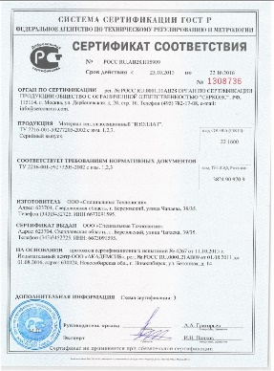
Fluid density
Density and apparent viscosity tests were carried out by the test center of Akademsib LLC. The test laboratory accredited in the Federal Accreditation Service (Rosakkreditacia), (reg. No. ROSS RU.0001.21AV09) performs particular product tests on indicators defined by the relevant rules and issues a test report.
http://www.akademsib.ru
Density tests – 0.5 kg/liter – were carried out in accordance with the requirements of GOST 31992.1-2012 “Paints and varnishes. Method for determination of density”. The standard covers liquid paintwork materials and liquid intermediates and establishes the pyknometer test. The test consists in determining the mass of the material tested, placed in the pyknometer of known capacity at a certain temperature.
http://docs.cntd.ru/document/1200102434
This standard is equivalent to ISO 2811-1:2011 “specifies a method for determining the density of paints, varnishes and related products using a metal or Gay-Lussac pyknometer”.
http://www.iso.org/iso/home/store/catalogue_ics/catalogue_detail_ics.htm?csnumber=50493
For details see: (appendix3. Akademsib)

Slide 11
Apparent viscosity
Apparent viscosity tests – 16,000 sP – 80,000sP – were conducted in accordance with the requirements of GOST 25271-93 “Plastics. Resins in the liquid state or as emulsions or dispersions. Determination of apparent viscosity by the Brookfield method”. This standard has been prepared by direct application of the international standard ISO 2555-89 “Plastics. Liquid resins, emulsions, and dispersions. Determination of Brookfield apparent viscosity” with the additional requirements that reflect the needs of the national economy.
http://docs.cntd.ru/document/gost-25271-93
On the basis of tests conducted, the following certificate has been issued by the products certification body Serkons LLC: the Certificate of Compliance of Russia, confirming the compliance of Isollat TU 2216-001-59277205-2002.
SERCONS Certification Authority is the leading Russian company in the field of certification. We issue the required certificates for Russia and the Customs Union… Sercons was established in 1996 and up to date we have 9 locations in Russia, one in Turkey, China, Japan and South Korea. In November 2013, Sercons established a new office in Zug, Switzerland so that we could be closer to our European clients and partners and still offer the competitive prices only available in Russia.
http://sercons.ch/ For details see: (appendix3. Akademsib)
(appendix9.certificate)

Slide 12

Film density
Tensile strength
Dry density tests – 0.3 kg/dm³ – in accordance with the requirements of GOST 17177-94 (Thermal insulating materials and products for building application. Test methods) were carried out on the basis of the Research Center of Uralplastic CJSC
“In this standard, along with methods of identifying the main performance properties of thermal insulating materials and products, the test methods are included as recommended..., which are adopted by the International Organization for Standardization (ISO).
The recommended methods can be used when supplying products for export, as well as serve as a base for later transition of the mineral wool industry to international test methods.”
http://www.gosthelp.ru/gost/gost27900.html
Tensile strength and elongation tests in accordance with the requirements of GOST 14236-81 (Polymer films. Tensile strength test method) were conducted on the basis of the Research Center of Uralplastic CJSC
http://www.uralplastic.ru
SC Uralplastic CJSC is a testing laboratory accredited in the Federal Accreditation Service (Rosakkreditacia), (reg. No. ROSS RU. 0001.22HI16). It has extensive experience in working with many large Russian organizations for testing physical properties of the products.
For details see: (appendix4. Uralplastic)

Slide 13
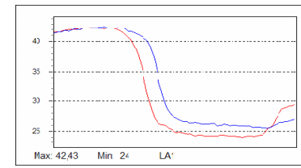
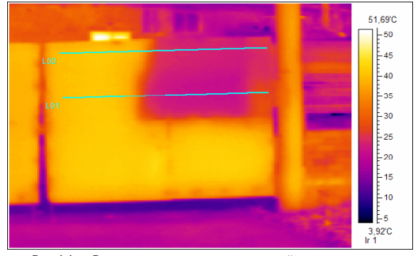
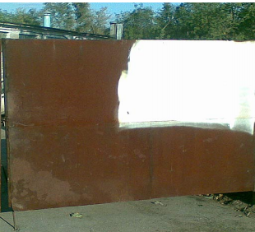
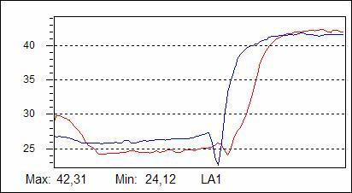
Light reflection of sunlight
Light reflectance value – 0.8 for 3 layers of 0.5 mm, obtained by the results of our own tests. The rusty gate of black metal was processed with Isollat-02. (with no additional surface treatment) After 15 months, measurements and thermal imaging photography were made at t = 16°C.
2 layers
1 layer
2 layers
3 layers
3 layers
1 layer
Temperature distributions on the front and back sides of the gate
For details see: (appendix5.Samara)

Slide 14
Shrinkage after drying
Weight of the dry film
Tests on shrinkage after drying – 5 % – were conducted by specialists of the testing laboratory of Special Technologies LLC on the methodology of comparative measurements of the coating in liquid state, using the thickness gauge for the wet layer (corresponding to ASTM D 4414 and GOST R 51694-2000), and in dry state with the help of magnetic thickness gage for coatings MT-101 (corresponding to GOST R 51649, GOST 18353, and ISO 2808)
Dry film weight – 0.15 kg/m² at 0.5 mm was obtained by calculations from known density in dry state. The density of the coating in dry state is equal to 0.3 kg/dm³, therefore the weight of the film with the thickness of 0.5 mm per 1 m2 is equal to: 0.3*1,000 / 1,000*2 = 0.15 kg/m²

Slide 15
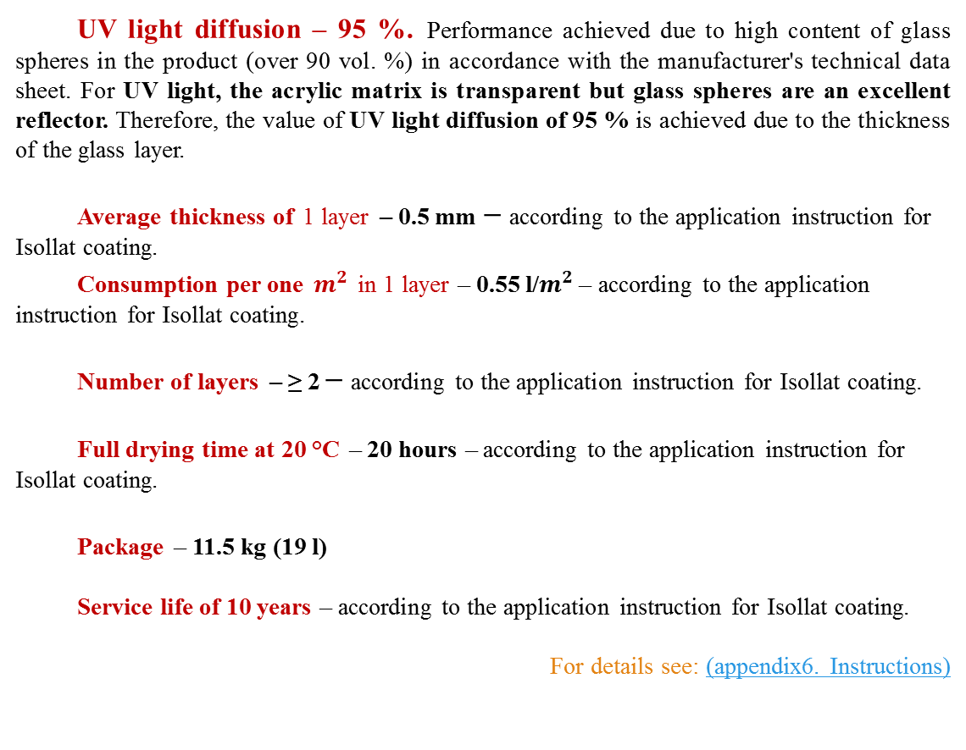
Application Instructions
UV light diffusion – 95 %. Performance achieved due to high content of glass spheres in the product (over 90 vol. %) in accordance with the manufacturer's technical data sheet. For UV light, the acrylic matrix is transparent but glass spheres are an excellent reflector. Therefore, the value of UV light diffusion of 95 % is achieved due to the thickness of the glass layer.
Average thickness of 1 layer – 0.5 mm – according to the application instruction for Isollat coating.
Consumption per one $m^{2}$ in 1 layer – 0.55 l/$m^{2}$ – according to the application instruction for Isollat coating.
Number of layers – ≥ 2 – according to the application instruction for Isollat coating.
Full drying time at 20 °C – 20 hours – according to the application instruction for Isollat coating.
Package – 11.5 kg (19 l)
Service life of 10 years – according to the application instruction for Isollat coating.
For details see: (appendix6. Instructions)

Slide 16
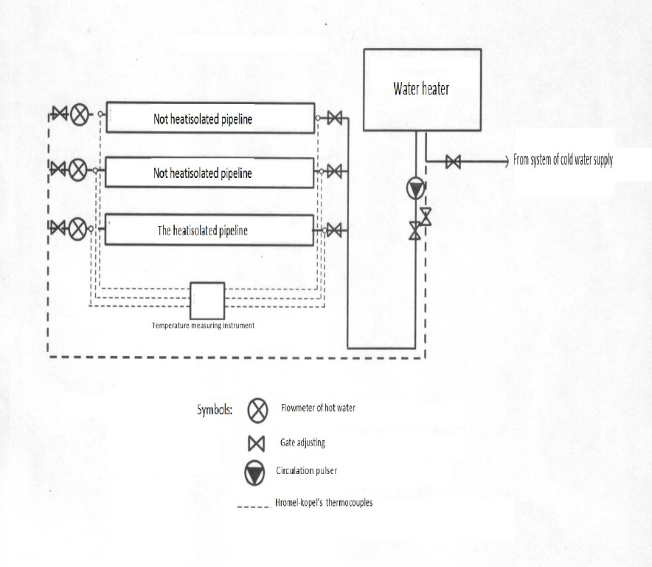
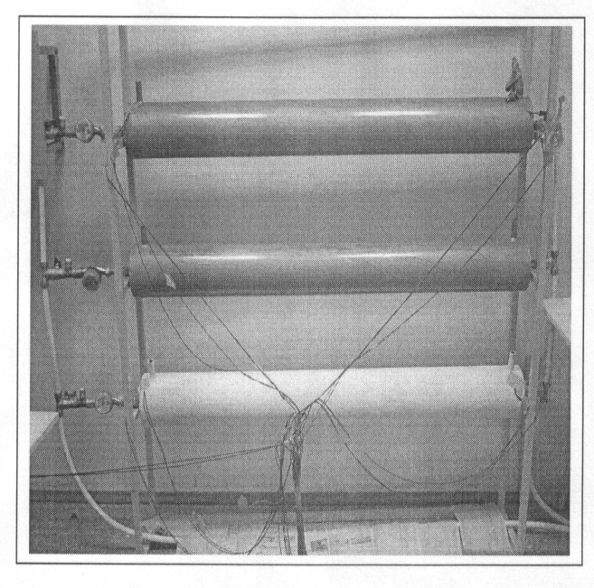
Heat transfer measurement
The heat transfer measurement was carried out at the test center Strojtest-Sibady. The company's main activities are research studies and development in the field of natural and technical science.
The testing laboratory accredited in the Federal Accreditation Service (Rosakkreditacia), (reg. No. ROSS RU.9001.21 SL97)
The tests were carried out on a specially constructed stand at the stationary thermal mode of the heat carrier and stable water consumption.
For details see: (appendix7. Sibadi)

Slide 17


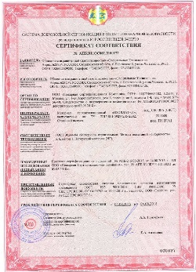
Fire Certificate
Flammability group Г1 (low-flammable) has been confirmed by tests of Pozharnaja Sertifikacionnaja Kompanija LLC (Fire certification company), a leading provider of fire certification with its fire laboratory. (Accreditation Certificate No. ROSS RU.0001.11PB68, valid before 30.10.2016)
All certificates issued by that body are included in the public registry.
The company has a large scope of accreditation, many years of work experience with major customers in Russia and abroad.
http://www.pskpb.ru
The Fire Certificate is issued on the basis of Certification Test Report of Pozharnaja Sertifikacionnaja Kompanija LLC. The testing laboratory of Pozharnaja Sertifikacionnaja Kompanija LLC is accredited (reg. No. ROSS RU.0001.11PB68, valid before 30.10.2016) in the Federal Accreditation Service (Rosakkreditacia)
http://fsa.gov.ru/
For details see: (appendix8. APB)

Slide 18

Anticorrosion coating
In the case of special anticorrosion requirements we recommend to use the products of international company JOTUN as an additional anticorrosion coating
International company Jotun operates territorially in 7 regions, where the decorative paints and functional coatings (industrial, marine, and powder) presented. The company accommodates 35 factories in 21 countries, has 65 companies in 45 countries, and is represented in more than 100 countries.
http://www.technicouleur.fr
Liquid coatings Jotun are specially designed for reliable protection of pipelines.
Jotun offers a range of solutions to protect taps, reinforcement, transverse welding seams, bends and fittings, valves and stop valves, new pipes.

Slide 19
Isollat coating usage efficiency
In 2011, the tests were carried out on evaluation of thermal properties of Isollat 02 coating.
The coating "Isollat-Effect” is a combined thermal insulation material with Isollat-02 which is widely applied as a coating for pipelines and industrial equipment with high surface temperatures.
Before application:
Actual coolant and environmental parameters:
The pipe surface temperature was +58°C.
2. Air temperature in the heating system manifold room, at the time of the measurements, was +24°C (floor), +27°С (ceiling).
3. The relative air humidity was 43.7%
Tests results for pipelines heat transfer:
Heat transfer for 1 m² without coating "Isollat-Effect" – 1475 W.
Heat transfer for 1 m² with coating "Isollat-Effect" – 189 W.
As a result of the tests, the heat losses for the tested area were decreased by factor of 8 (1475W/ 189W=7,804)
After
application

Slide 20
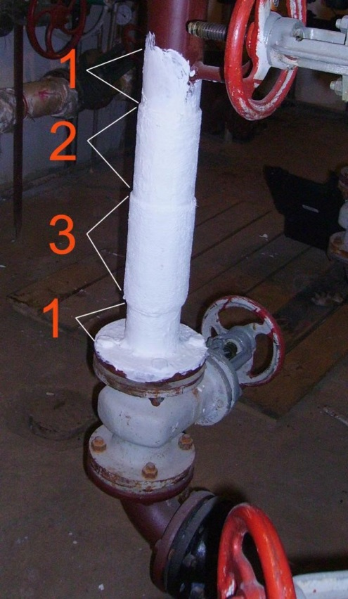
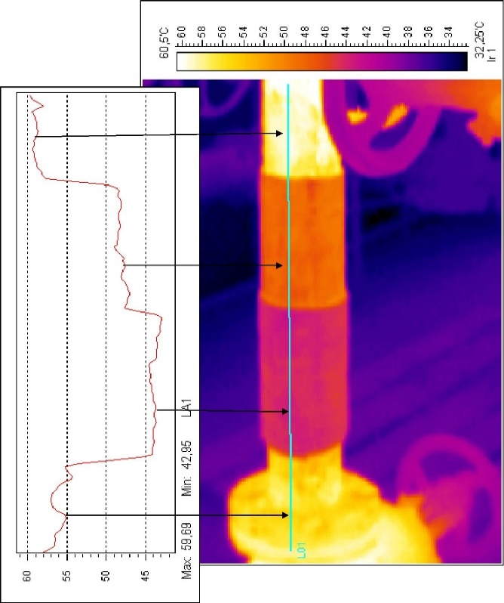
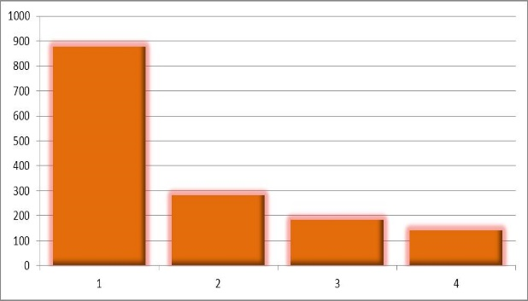
Isollat coating usage efficiency
Area 1: Isollat 02 (0.5 mm).
Area 2: Isollat 02 (0.5 mm) + Geotextile fabric (1 layer) + Isollat 02 (0.5 mm)
Area 3: Similar to Area 2 + Geotextile fabric (1 layer) + Isollat 02 (0.5 mm)
Temperature at the surface of the coating.
Heat flux density measurement
As a result of the tests, the heat losses for the tested area were decreased by factor of 6 (876 W/m²/141 W/m² = 6,2)
Open pipe. | Surface 1 | Surface 2 | Surface 3
876 W/m² | 283 W/m² | 184 W/m² | 141 W/m²

Slide 21
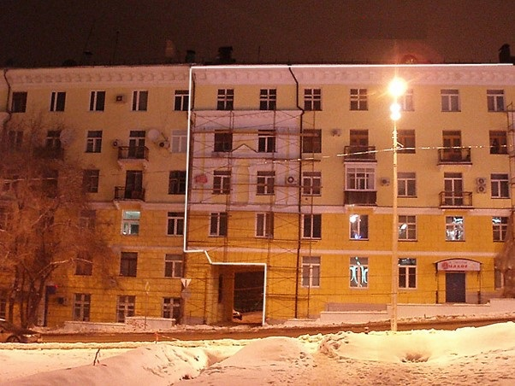
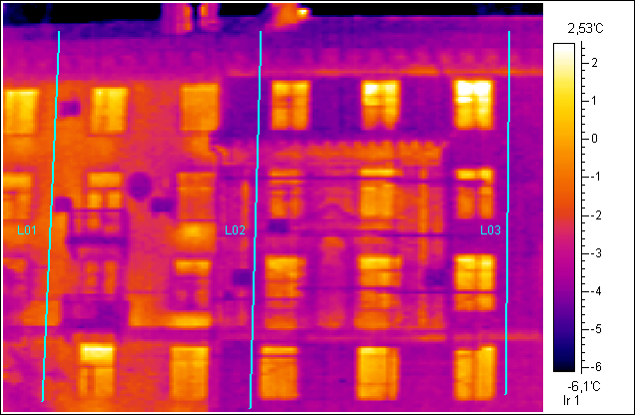
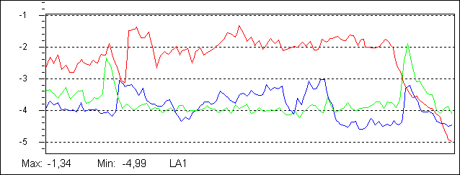
Isollat coating usage efficiency
Comparative thermal imaging photography of coated and not coated part of the building face at -4°C
Heat insulated
L01
L03
The left half of the building is not insulated. The right part is insulated with Isollat 02, thickness 1.5 mm.
Thermal imaging photography revealed the temperature difference of 2°C
L02

Slide 22
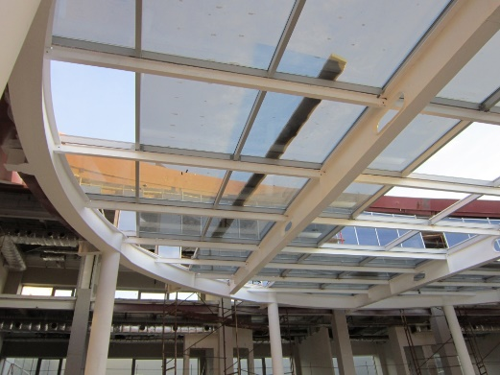
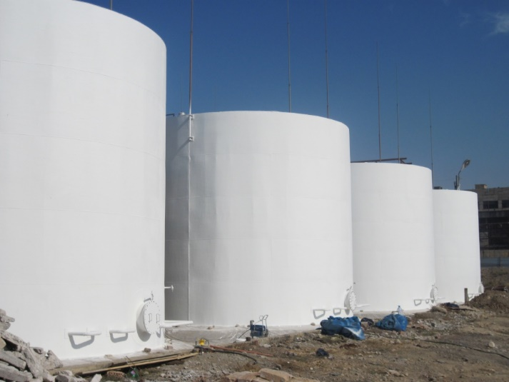

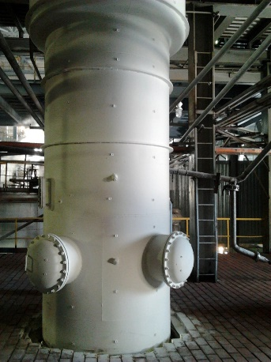
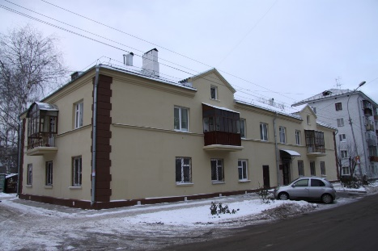
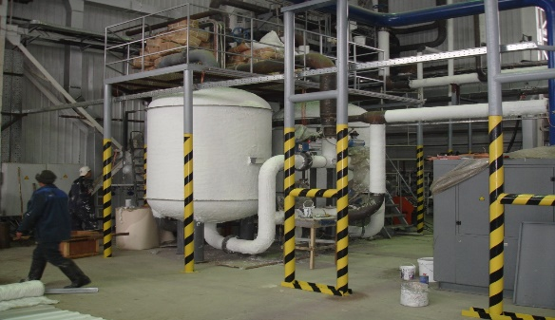
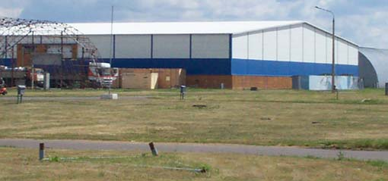

Usage in CIS and EU
Liquid ceramic coating Isollat is widely used in the territory of the Russian Federation, as well as in CIS countries (Republic of Kazakhstan, Republic of Belarus), in EU countries (Poland, Lithuania), and in the territory of the Republic of Turkey.

